Slide 1
ANNOUNCEMENTS FOR SHAREPOINT & MORE

Slide 2
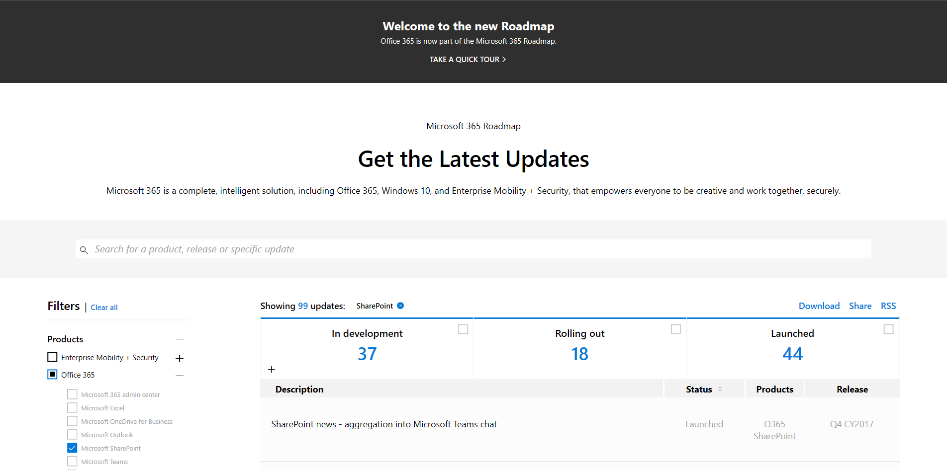
NEW ROADMAP MICROSOFT 365
https://www.microsoft.com/en-us/microsoft-365/roadmap

Slide 3
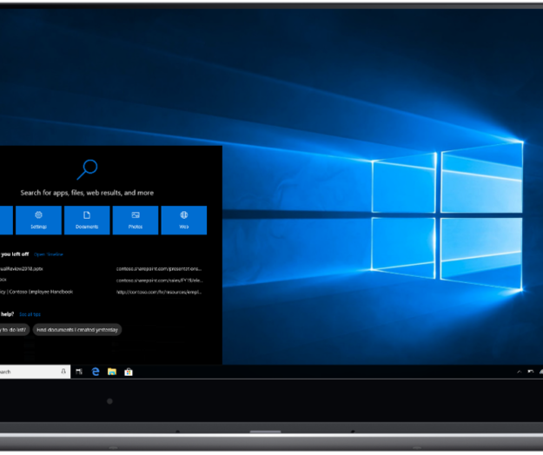
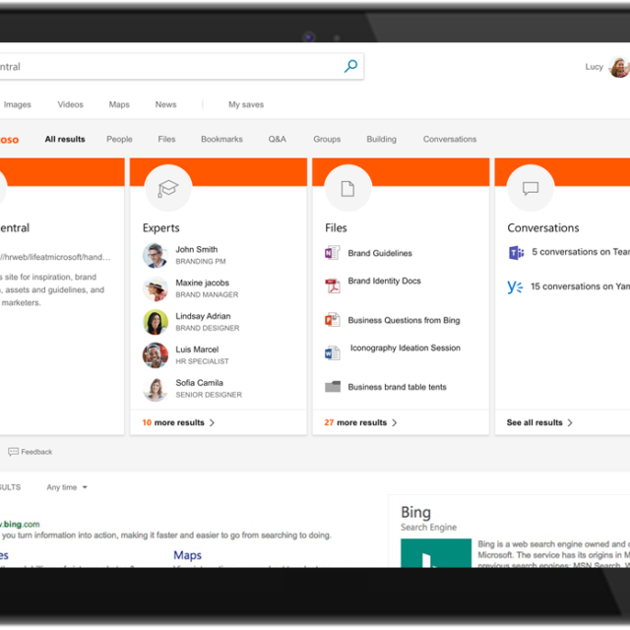
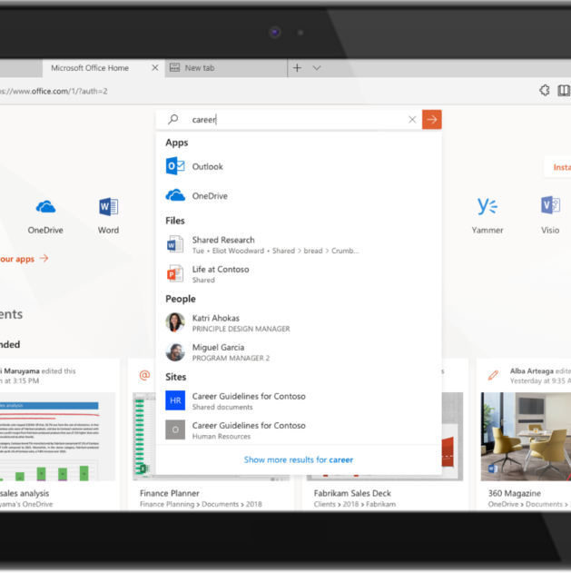
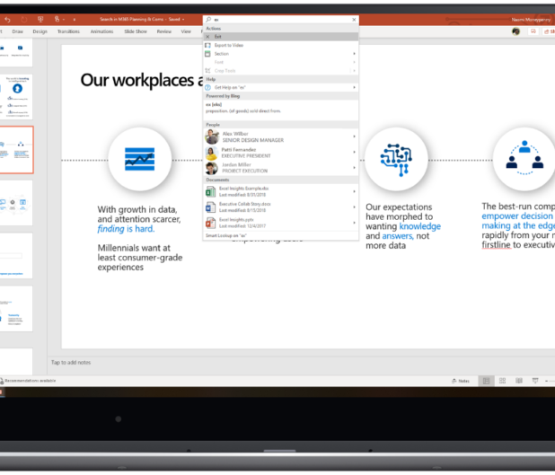
Microsoft Search
Resources:
Blog: Microsoft Search – cohesive search that intelligently helps you find, discover, command, and navigate
Ignite Session: BRK3023 – Getting started with Microsoft Search
Ignite Session: BRK2103 – Accelerate productivity with search and discovery in SharePoint, Bing for Business, and across Microsoft 365
Documentation: Microsoft Search in Bing
Notes:
Wouldn’t it be great if you could get results from all of your Office 365 services no matter what app or service you were in? This can drastically improve productivity using an intelligent search capabilities. One search to rule them all in Office 365 and Windows. Not only does it provide results but it will surface Apps, lists, and more for interaction directly from the search results. SharePoint, OneDrive, Teams, Yammer, Groups, and more all side by side…
Search will be available from:
Office 365 Search Bar
Office Client App Search
Mobile Applications
Bing.com
Windows Search

Slide 4
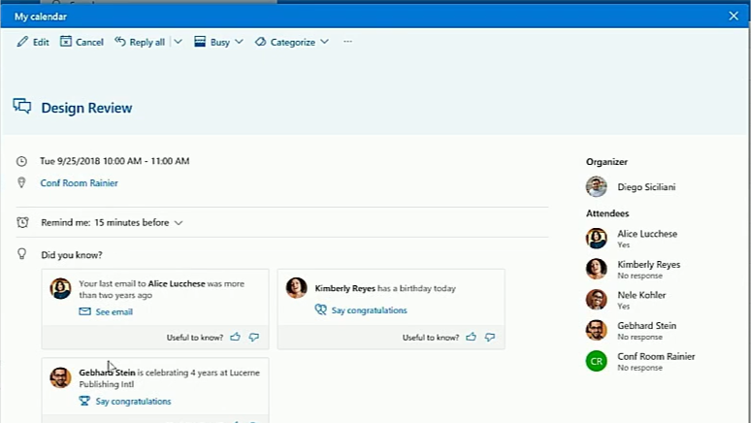
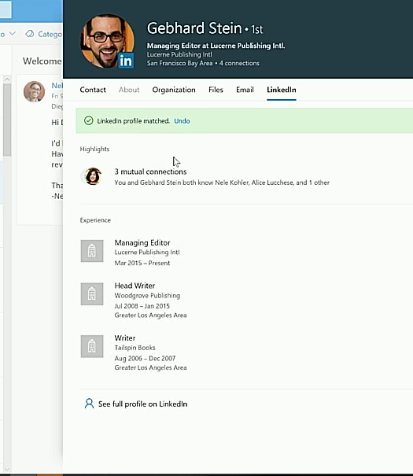
LinkedIn Integration
Capabilities:
Rich Profile Cards
Meeting Cards
Collaborate on documents with LinkedIn users
Resources:
Blog: Achieve more through people with LinkedIn and Microsoft 365
Ignite Session: BRK2249 –Success through people with LinkedIn and Microsoft 365
Notes:
LinkedIn can provide another avenue to working with others. Card integration within meetings can provide insight and talking points prior to the meeting to help you prepare. Collaborating on content can happen with LinkedIn users, integration with Dynamics sales can surface insights for sellers.

Slide 5
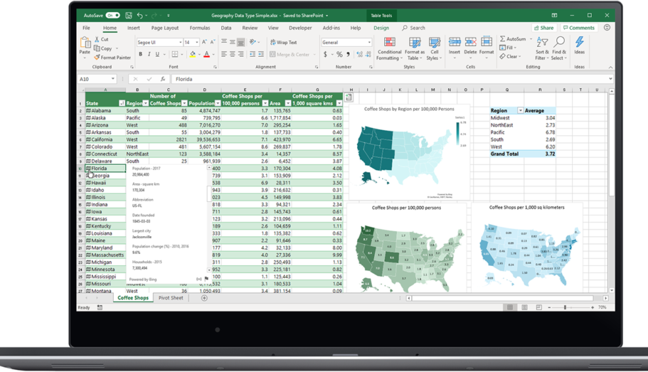
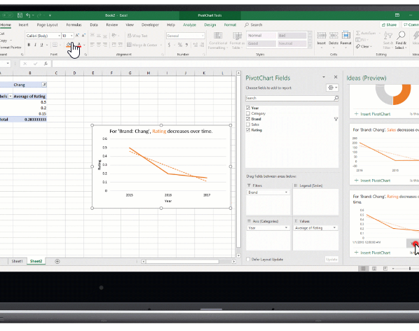
Office Apps - Excel
New Features:
Ideas
New data Types
Insert Data from Picture
Dynamic arrays
Performance Improvements
Resources:
Blog: Bringing AI to Excel – 4 New Features
Ignite Session: BRK2122 – What’s new in Microsoft Excel

Slide 6
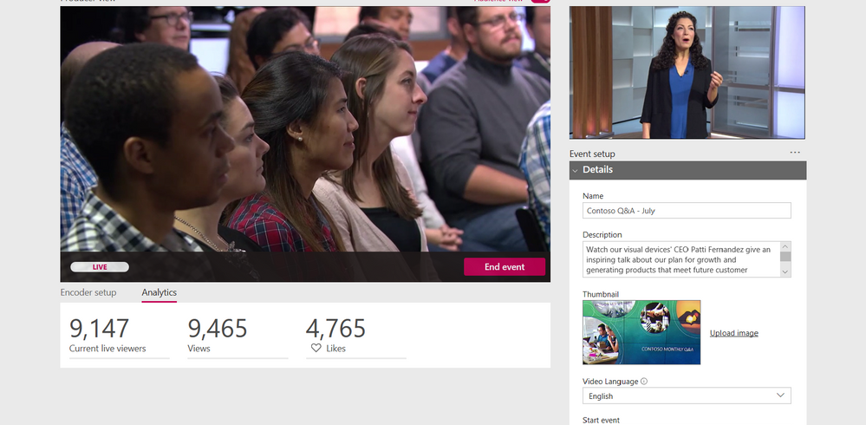
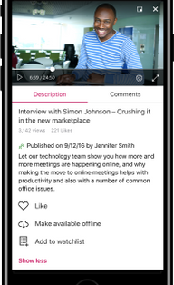
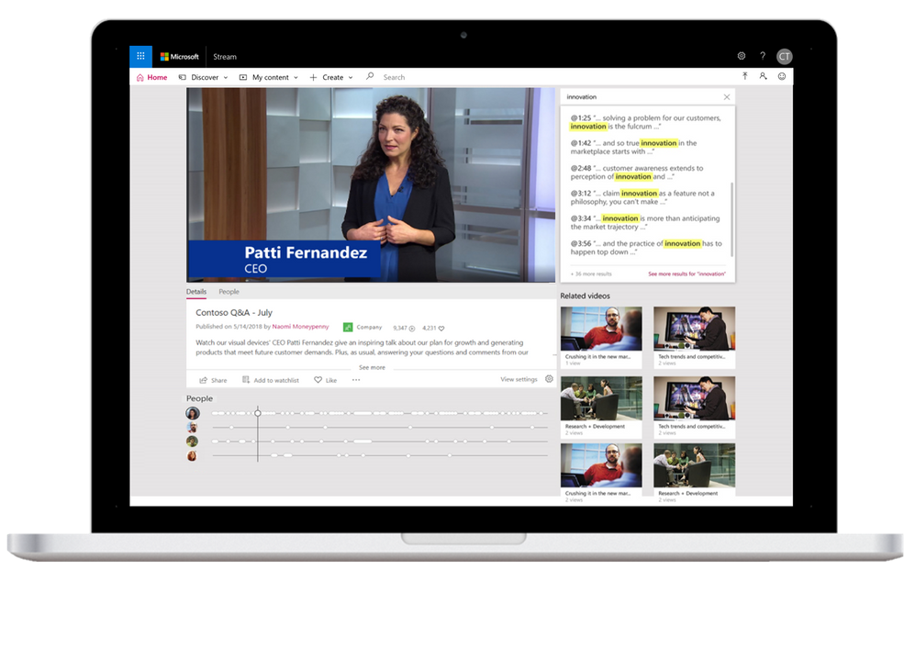
Microsoft Stream
New Capabilities
Live Events
Mobile Offline Videos (Stream Mobile App)
Meeting Recordings with deep search
AI Capabilities (Timelines, Transcription, Search) are now across all skus
Resources
Blog: What’s new in Microsoft Stream – Ignite 2018 announcements
Ignite Session: THR2338 – Introduction to Microsoft Stream: Engage and inform your organization with intelligent video
Ignite Session: BRK2132 - Transform how your organization uses video with Microsoft Stream live event streaming, mobile enhancements and deeper integrations across Office 365
Ignite Session: BRK2422 - Successfully embrace video adoption across your organization with Microsoft Stream
Ignite Session: THR2309 - Microsoft Stream updates for hosting live events and more
Ignite Session: THR2373 - Managing an intelligent live events service across Microsoft Teams, Yammer, and Stream in the Microsoft enterprise
Documentation: Microsoft Stream
Notes:
Live events can help to:
Reach any audience, anywhere, anytime with engaging communications – from informal webinars to professional studio broadcasts
Empower everyone to share knowledge and expertise quickly and easily
Drive engagement with real-time discussion, interactions and on-demand video
Unlock content with AI (artificial intelligence) in on-demand live events to find every moment that matters
New features:
Live Events
Mobile Offline Videos (Stream Mobile App)
Meeting Recordings with deep search
AI Capabilities (Timelines, Transcription, Search) are now across all skus

Slide 7
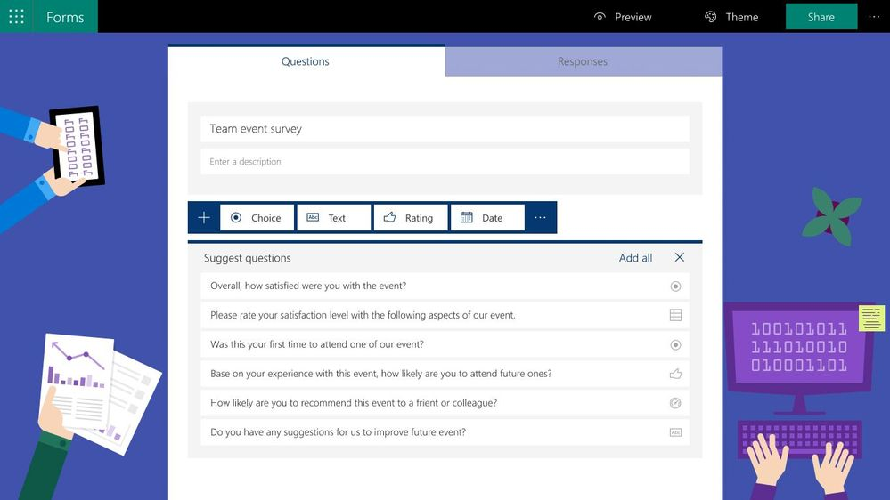
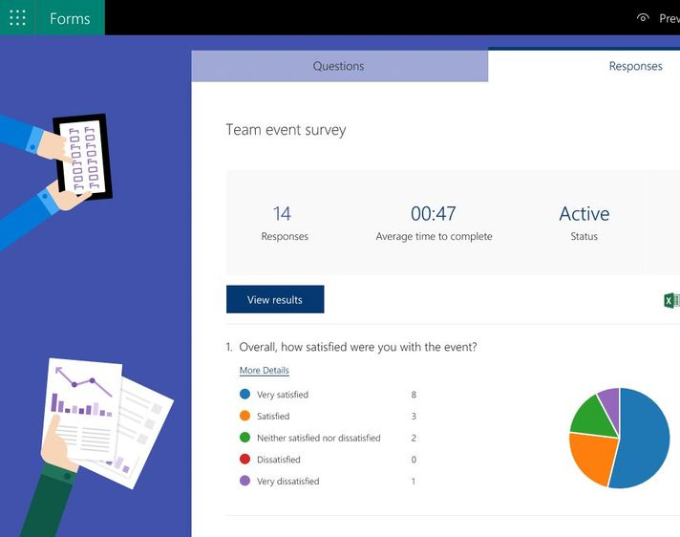
Microsoft Forms
New Capabilities:
Improved Intelligence
Form Ideas
New Question Type (Net Promotor Score)
Branding Enhancements
Improved Administration
Accessibility
PowerPoint Integration
Upload File Attachments (users must be authenticated)
Resources:
Blog: Announcing new Forms features at Microsoft Ignite
Ignite Session: BRK – Smart Microsoft Forms for everyone to easily create survey, polls, and quizzes
Notes:
Use cases: Customer Feedback Survey, Employee Ideation, Quick Quiz (Training)
New Capabilities:
Improved Intelligence – Suggestions based on context of survey - https://techcommunity.microsoft.com/t5/Microsoft-Forms-Blog/Design-Intelligence-in-Microsoft-Forms/ba-p/257860
Forms Ideas – On the fly reporting and aggregation of results to allow for rapid analysis without jumping through excel and formulating on your own - https://techcommunity.microsoft.com/t5/Microsoft-Forms-Blog/Welcome-to-Forms-Ideas-Analyze-Your-Response-Data-Smartly-in/ba-p/262515
New Question Type - You can now add Net Promoter Score (NPS) questions to your forms. NPS questions are the default method for measuring respondent sentiment about a particular activity.
Branding Enhancements - Forms can now better represent your company’s brand with improved customization for survey logos, themes, backgrounds, and “Thank You” pages
Improved Administration - https://techcommunity.microsoft.com/t5/Microsoft-Forms-Blog/Microsoft-Forms-is-GDPR-compliant/ba-p/251515

Slide 8
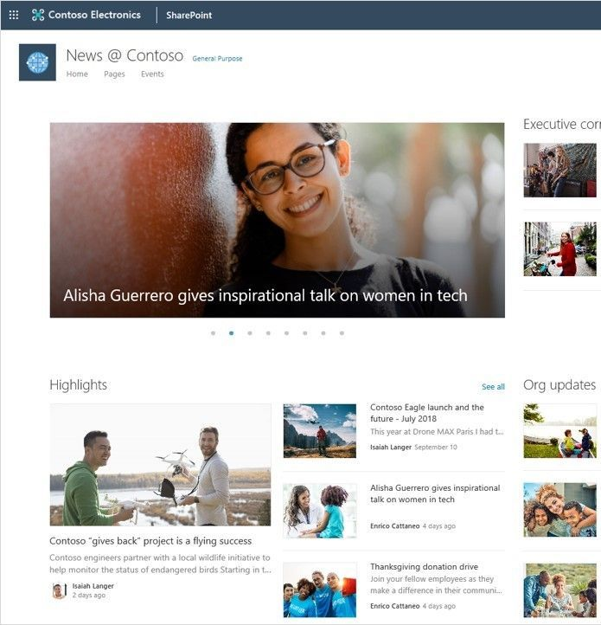
SharePoint Online
Portals
Content Services
Business Process
Developer

Slide 9
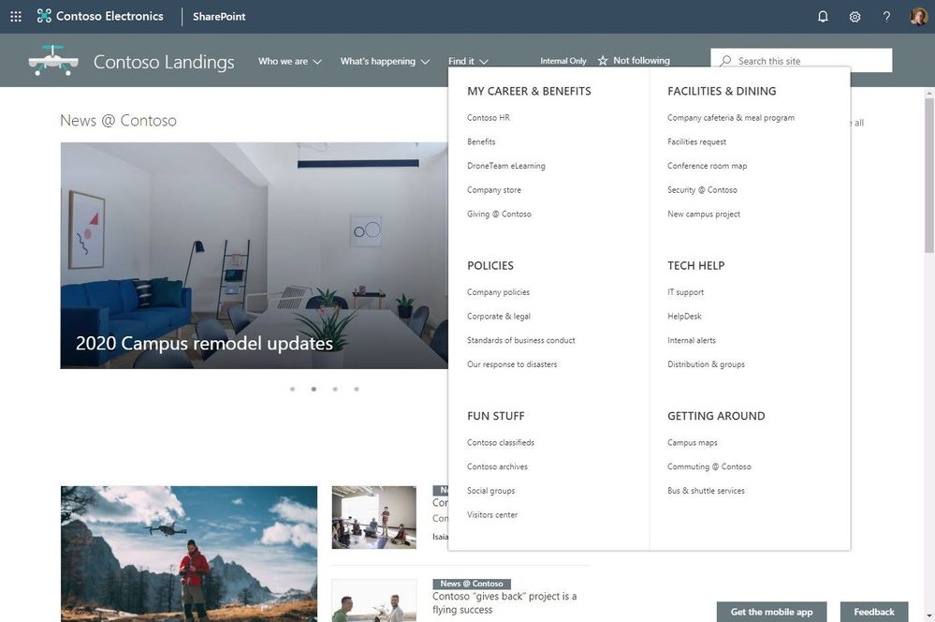
SharePoint Online Megamenu
The new megamenu options allow for multiple levels of hierarchy at once - no fly-outs needed.
Notes:
Increase the value and space of your site navigation. The new megamenu options allow for multiple levels of hierarchy at once - no fly-outs needed. This will enable you to better organize and showcase the related content and sites associated under that hub site.

Slide 10
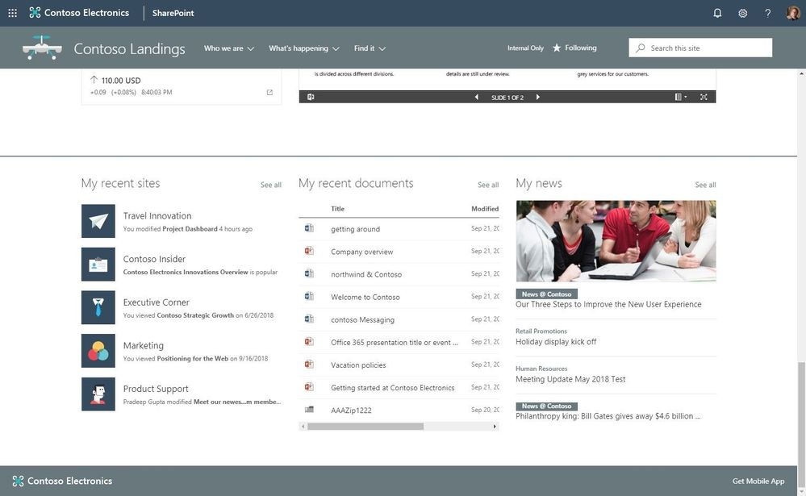
SharePoint Online Web Parts
Personalized Web Parts:
Give a personalized experience to your site and page visitors – so they see the content that is theirs, and meant for them to experience
Notes:
Give a personalized experience to your site and page visitors – so they see the content that is theirs, and meant for them to experience. When using personalized webparts, people will see their recent sites, their recent documents and news tailored for them. You can personalize any page or news article. When you add a personalized webpart to the page, it is aware of who is signed in and gives them a unique, relevant experience to the content and information you are promoting to them.

Slide 11
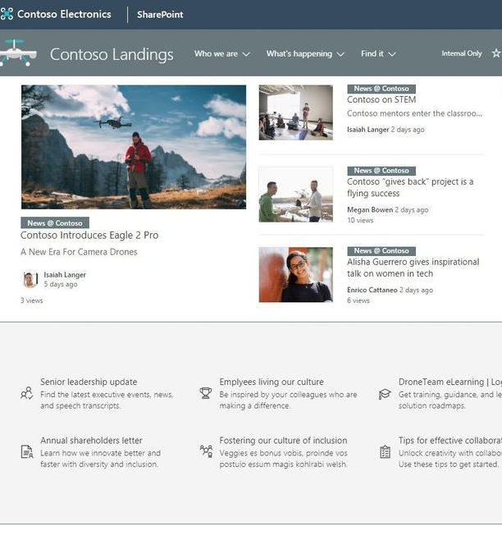
SharePoint Online Web Parts
Audience targeting for News and Highlighted content webparts:
You can better define what news articles and pages appear on the home experience of your site by configuring what is visible to specific groups.
Notes:
You can better define what news articles and pages appear on the home experience of your site by configuring what is visible to specific groups. Each person will have a unique experience that complies with what you wish them to view without creating multiple audience-specific sites, you can serve them all from within a more centralized location with a personalized, targeted experience. Audience targeting support will be enabled in news, pages and other web parts so that you can define and target who best to reach with content and site experiences by using Office 365 Groups.

Slide 12
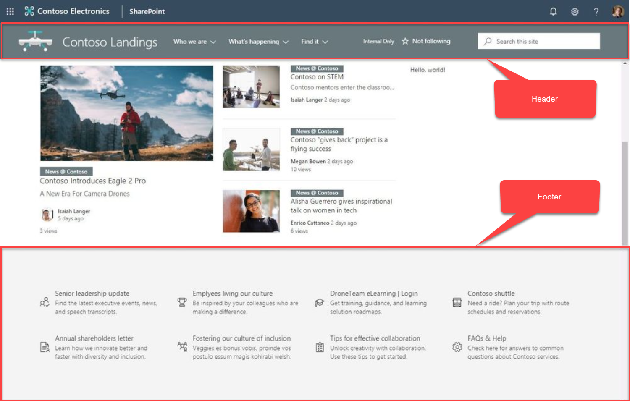
SharePoint Online Branding
Sites: header layouts Reclaim some of the vertical space at the top of the site. There will be three new choices: standard, minimal and compact.
Sites: adjust the footer of a site Add a site footer to showcase common information you wish to highlight at the bottom of your site.

Slide 13
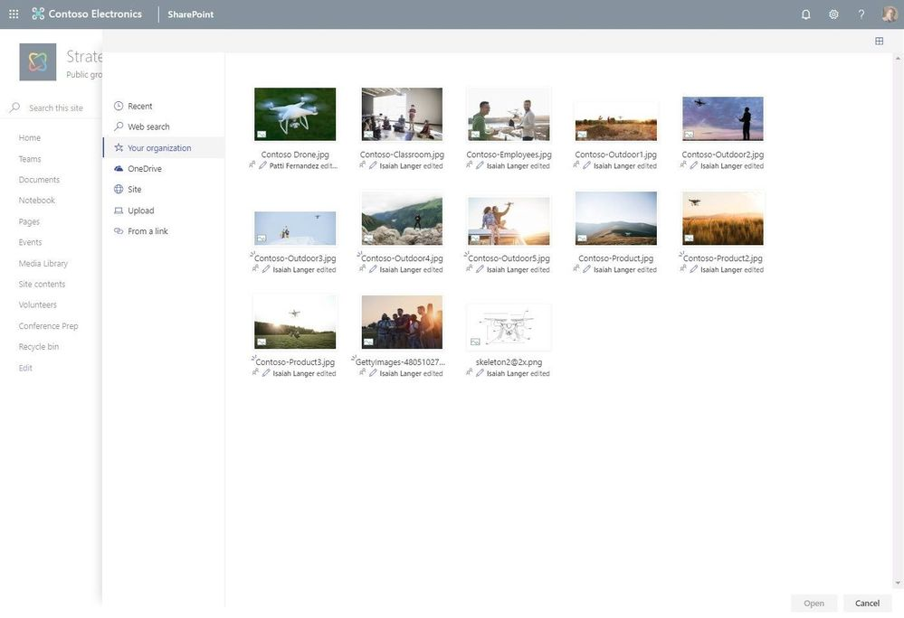
SharePoint Online Branding
Central asset library
Provide easy access to your organization’s approved images that can be leveraged by everyone.
Notes:
When a person needs an approved image, or one that was purchased for licensed use throughout the intranet, they can click on “Your organization” and navigate files and folders of assets that are centrally managed for use in title regions and the Image webpart.

Slide 14
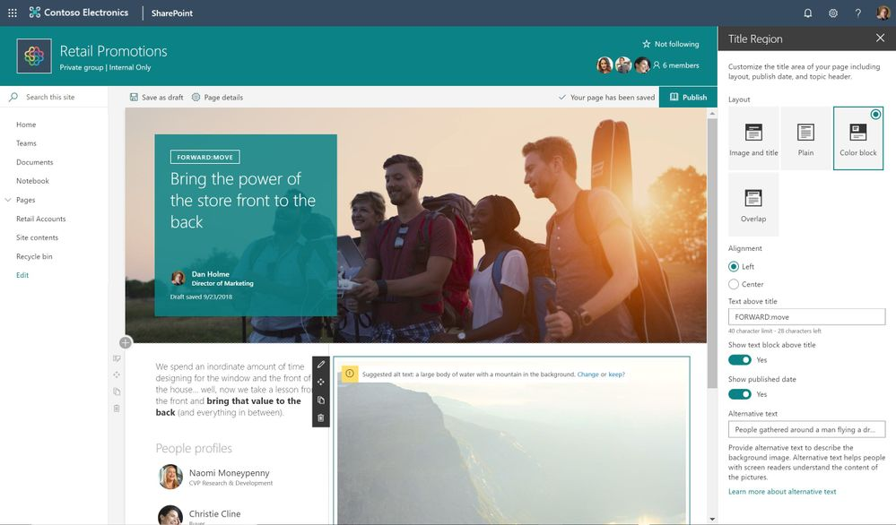
SharePoint Online Branding
Page Title Region Options
Choose from several layout options, alignment of where the overlay text resides, add text labels, show published date and author and provide alternative text to enhance the accessibility of your page.

Slide 15
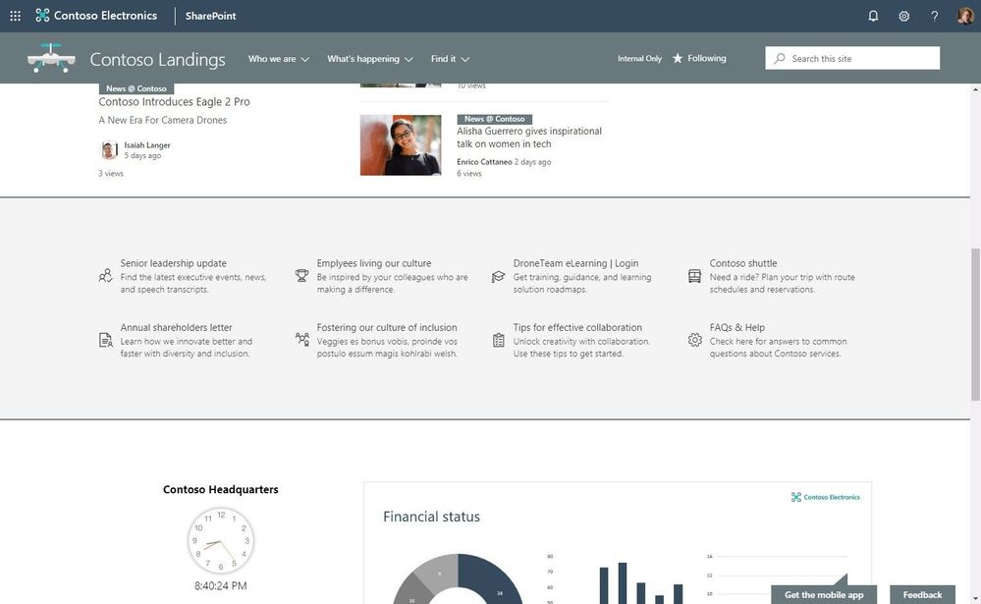
SharePoint Online Branding
Page Section Background Shading
Create additional visual design and clarity as a user scrolls through your content.
Notes:
Now you can add different colors to the background of your page sections or leave them white as they are by default.

Slide 16
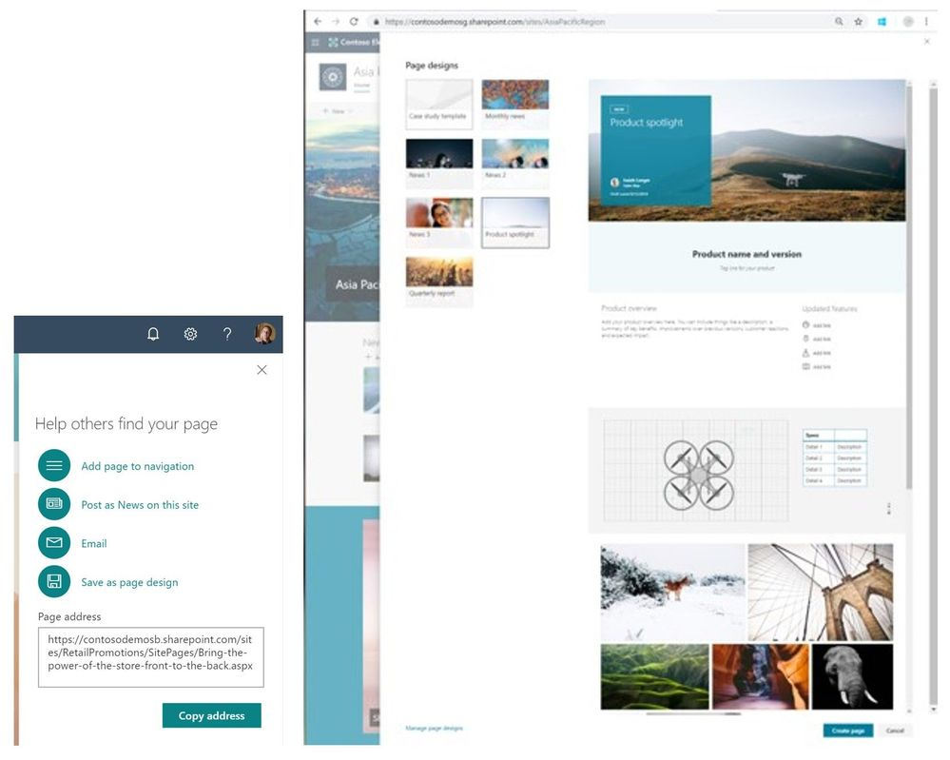
SharePoint Online Branding
Page designs to reuse and standardize content
Save your creators time when they generate new SharePoint pages
Notes:
You can control the design and layout of your pages by simply designing one that can then be used by many.
Now duplicate entire sections or individual webparts to speed up your page creation experience.

Slide 17
SharePoint Online - Other
Countdown Timer Web Part - Show a countdown timer to important launch dates, key meetings, campaign ends, etc. on their site home page, within subpages and/or within a news article on team sites, communication sites and hub sites.
Enable communication site experience at the root of a tenant - It’s time for this to be a real place to communicate. New tenants will automatically receive modern sites.
Part to Part communication - web parts talk to other web parts and your pages and experiences become more dynamic with data and interactive
Notes:
Initially we will support dynamic data in a few of our 1st-party webparts, with the intent to grow these capabilities through the SharePoint Framework - more and more web parts (talking to other web parts).
List (data provider)
List properties (consumer)
File viewer (consumer)
Embed (consumer)

Slide 18
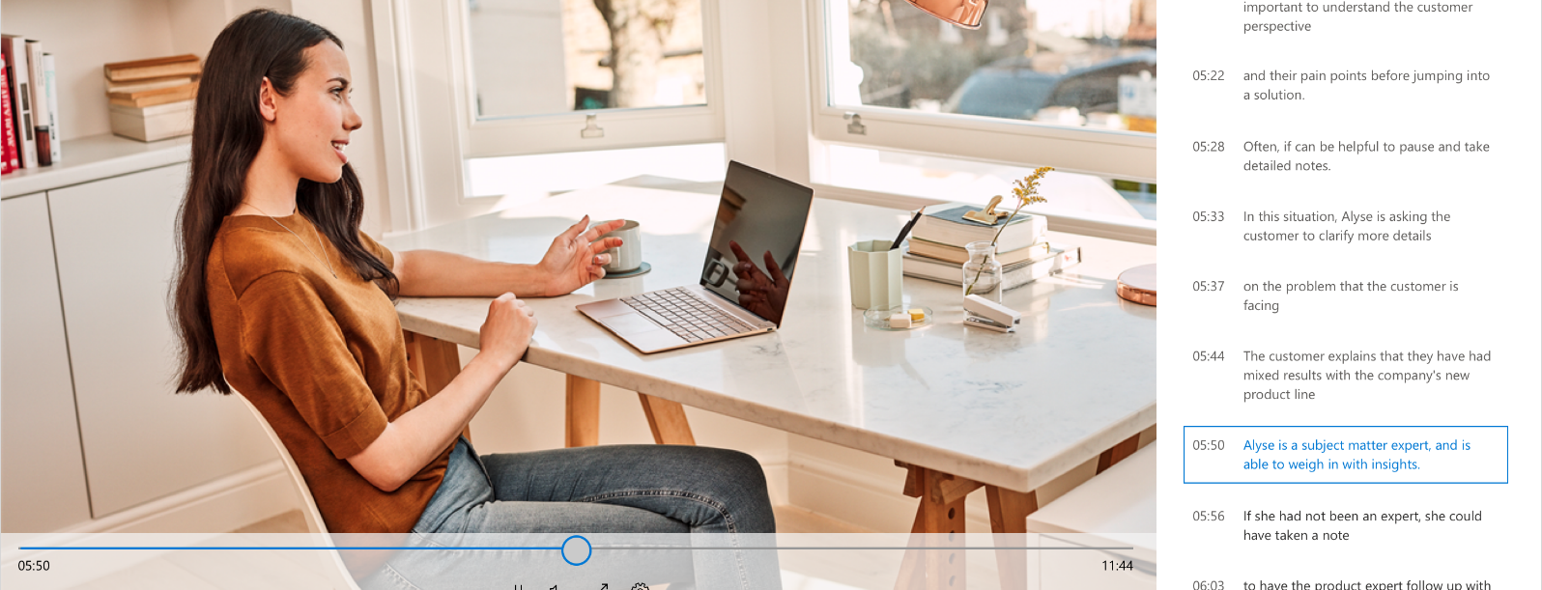
SharePoint Online Transcription
While viewing a video or listening to an audio file, a full transcript (improving both accessibility and search) will show directly in our industry-leading viewer, which supports over 320 different file types.
Notes:
automated transcription services will be natively available for video and audio files in OneDrive and SharePoint using the same AI technology available in Microsoft Stream. While viewing a video or listening to an audio file, a full transcript (improving both accessibility and search) will show directly in our industry-leading viewer, which supports over 320 different file types. This will help you utilize your personal video and audio assets, as well as collaborate with others to produce your best work.

Slide 19
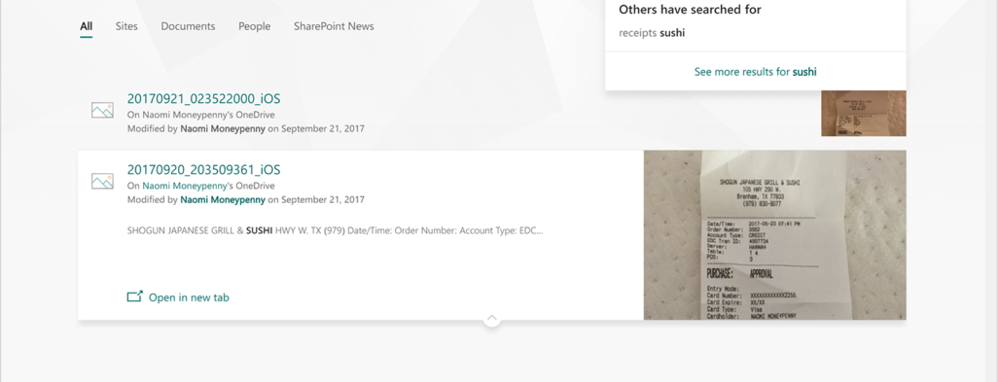
SharePoint Online Enhanced Search
Using native, secure AI, we determine where photos were taken, recognize objects, and extract text in photos. This recognition and text extraction allows you to search for images as easily as you search for documents.

Slide 20
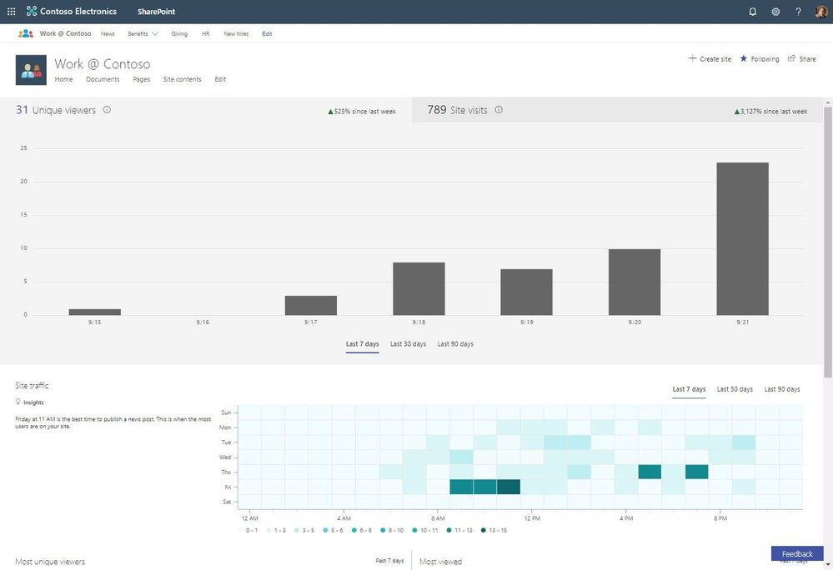
SharePoint Online Site Activity
Heat map - insights on site activity shows site traffic patterns
Discover when people most often visit your site, so you can best target and reach people for important announcements and events

Slide 21
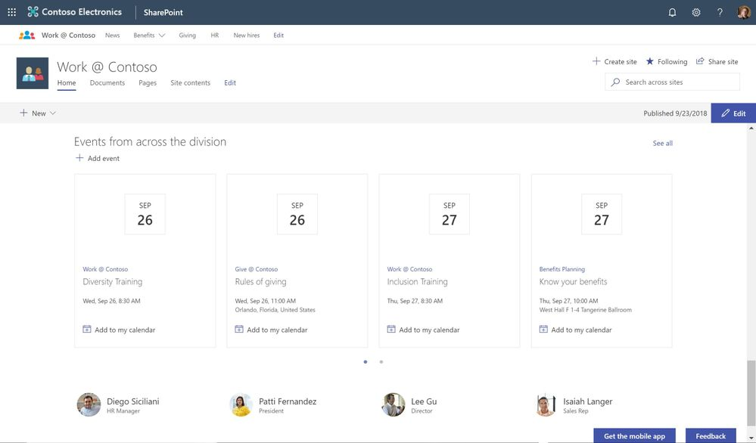
SharePoint Online Hub Sites
Events web part rolls up events - Aggregated view of all events appears at the hub site level
Create associated site from within hub site itself
Create, associate/disassociate, plus report on hub sites in the SharePoint admin center in Office 365
Approval on association
Hub site increase up to 100 associations
Notes:
Events web part rolls up events from associated sites - Like the News web part and Site activity, commonly used on the home page of a hub site, you can now leverage the Events web part to roll events up from associated sites so that the aggregated view of all events appears at the hub site level.

Slide 22
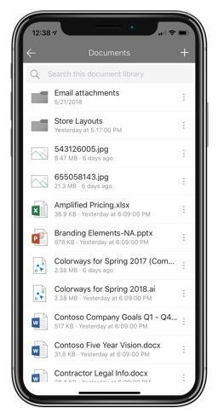
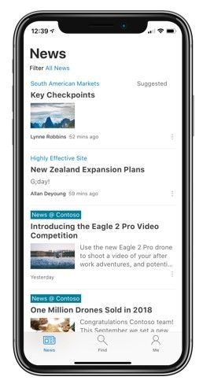
SharePoint Mobile Enhancements
Document Library Access
Organizational news support
Create news links
@mentions with comments
Notes:
Document library access – Stay within the mobile app for viewing and navigating
Organizational news support – More control, process and reach for publishing
Create news links – pull in news from external sources
@mentions – tag people directly from news to bring them into the conversation

Slide 23
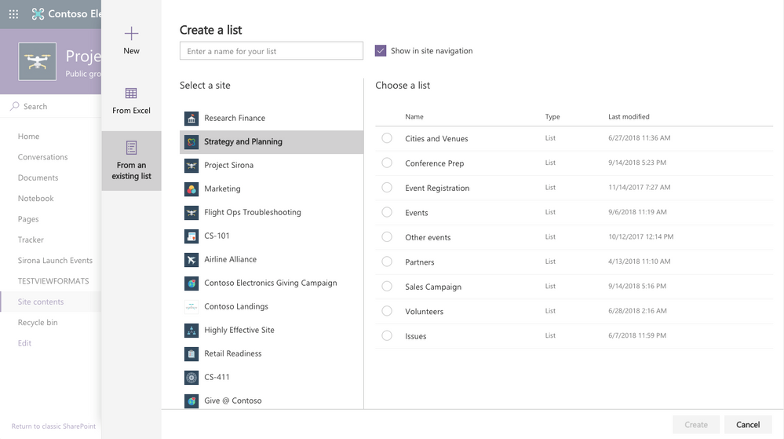
SharePoint Online Business Process
Improved List Creation

Slide 24
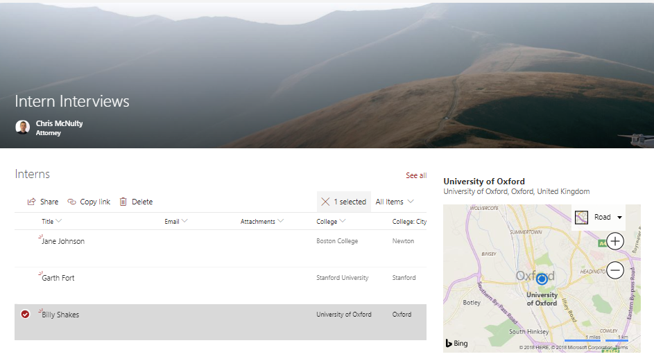
SharePoint Online Business Process
Location Columns
Our new location column allows you to browse Bing-based mapping data to tag items and documents with location data
Notes:
Locations can greatly enrich any business data – but coordinating multiple fields for coordinates, address, and location names can be hard. Our new location column allows you to browse Bing-based mapping data to tag items and documents with location data. You can even filter and sort on any aspect of the location, like city or state. And you can also include locations in your organization directory, such as meeting rooms. [Coming Q4 2018]

Slide 25
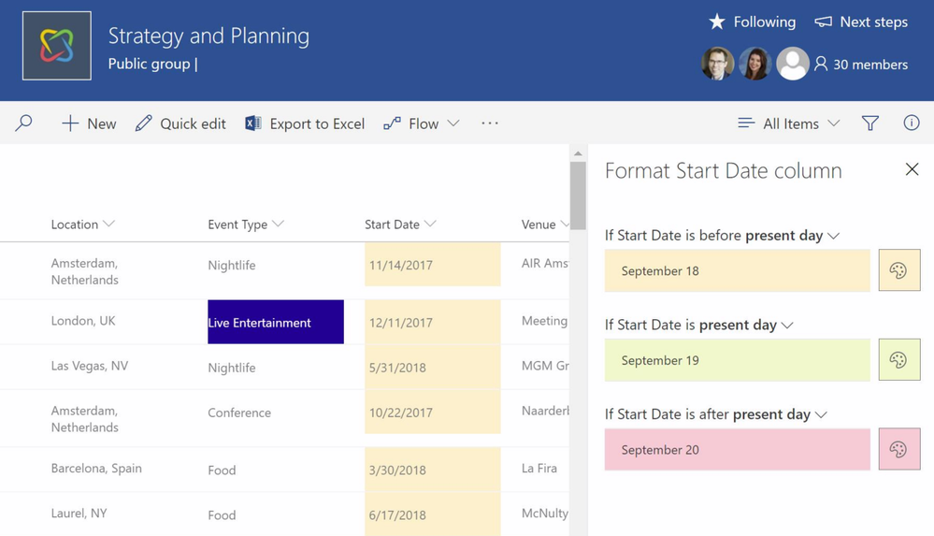
SharePoint Online Column Formatting
Conditional Formatting Create conditional formatting without using any JSON scripts.
Notes:
Last year we introduced column formatting, which lets you use cut-and-paste JSON scripts to bring visualization, formatting and interactivity to SharePoint columns. Coming soon, you’ll also be able to conditional formatting without using any JSON scripts. [Coming Q4 2018]

Slide 26
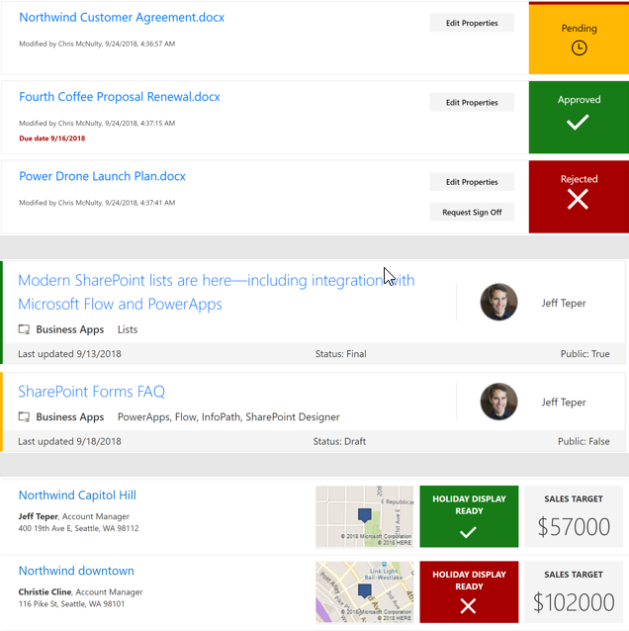
SharePoint Online View Formatting
Conditional formatting
Apply styling to a row, depending on that field’s value
Multiple line displays
Break through the single line constraints for traditional list/library formats
Flow buttons
Create an integrated button that kicks off approvals and flows
Immersive experiences
Create a responsive single page app that redefines the complete user experience on browser and mobile

Slide 27
SharePoint Online
Predictive indexing – Lists and Libraries up to 30 million items
View Formatting
Generate Site Actions

Slide 28
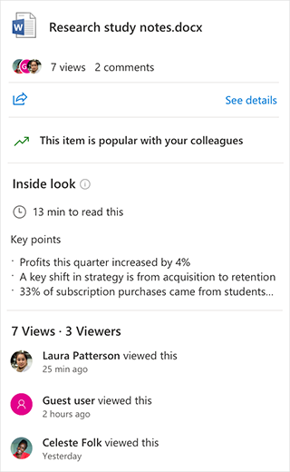
SharePoint Online Content Services
File card - Allows you to hover over a file name in Office 365 to explore new content intelligence, such as readability and key points found in the documents
Notes:
The file card allows you to hover over a file name in Office 365 to explore new content intelligence, such as readability and key points found in the documents. Key points can also be edited directly in SharePoint. [Coming Q4 2018]
OneDrive to the rescue with intelligence to help you better prioritize and optimize time by showing you how much time it takes to read a document and summarizing the key points all in the hovercard.
We’ve also extended the view analytics to files that are not Office documents and can now show you when a guest or anonymous user has viewed your file.

Slide 29
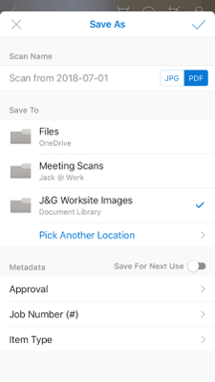
SharePoint Online Content Services
Mobile capture - Mobile capture on OneDrive Mobile lets you enter any default metadata when you’re saving files directly to a SharePoint library.
Notes:
The OneDrive mobile app is an easy way to scan documents and images into SharePoint or OneDrive. From on-the-go workers to traditional office locations, people need to be able to capture images for uses like site inspection, meeting notes, lab activities or event management. But integrating new documents into business processes often requires custom metadata to allow business process to run quickly and with precision – without waiting for someone to retag images inside a browser. Now, mobile capture on OneDrive lets you enter any default metadata when you’re saving files directly to a SharePoint library.

Slide 30
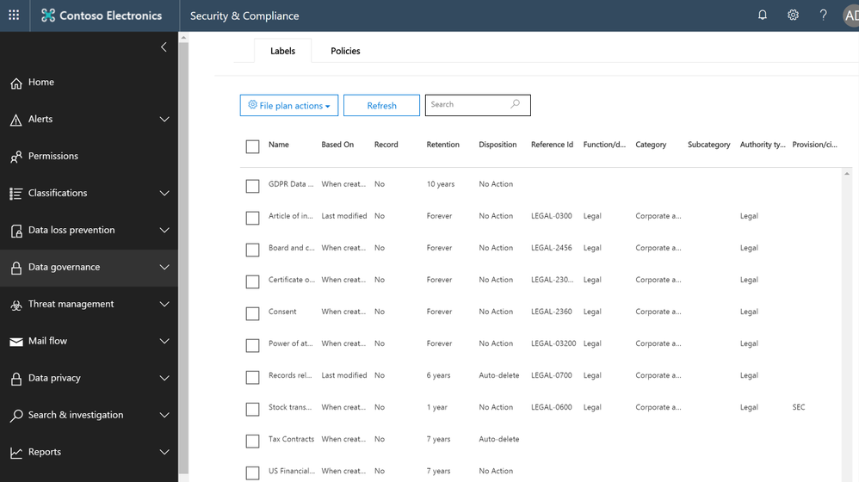
SharePoint Online Content Services
File Plans - Manage a range of retention labels with identifiers, departments, categories, statutory references and more
Notes:
Office 365 already provides data governance labels to establish rules for records management and retention. Later this year we’ll be augmenting those with hierarchical file plans, allowing you to manage a range of retention labels with identifiers, departments, categories, statutory references and more. File plans can be exported from Office 365 for easy editing in Excel, and then reimported to update label rules.

Slide 31
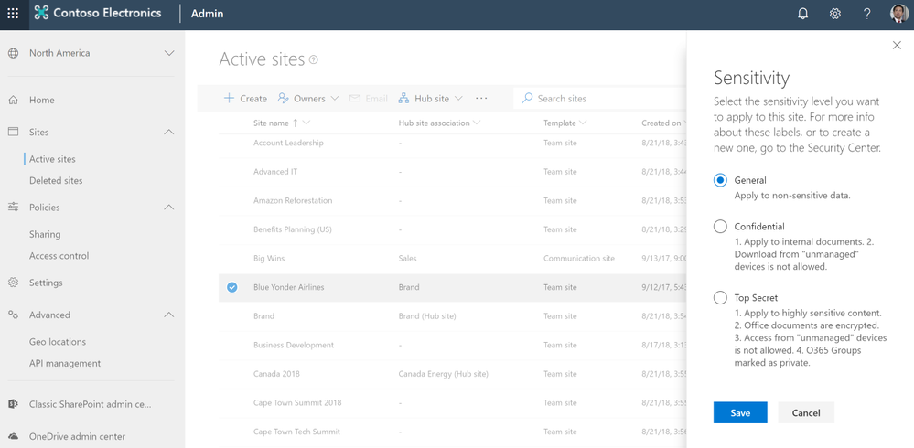
SharePoint Online Content Services
New label capabilities:
Immutable record labels
Sensitivity labels
Notes:
Microsoft has already had labels to establish retention and records management. Later this year, we’re releasing two new label capabilities:
Immutable record labels, to be used to make content permanently unchangeable and undeletable
Sensitivity labels – which can be applied to content to enforce security behaviors such as encryption, watermarking, data loss protection and remote device access. Sensitivity labels can also be applied by default to a container, such as a SharePoint site, to enforce security standards on all the content in that location.

Slide 32
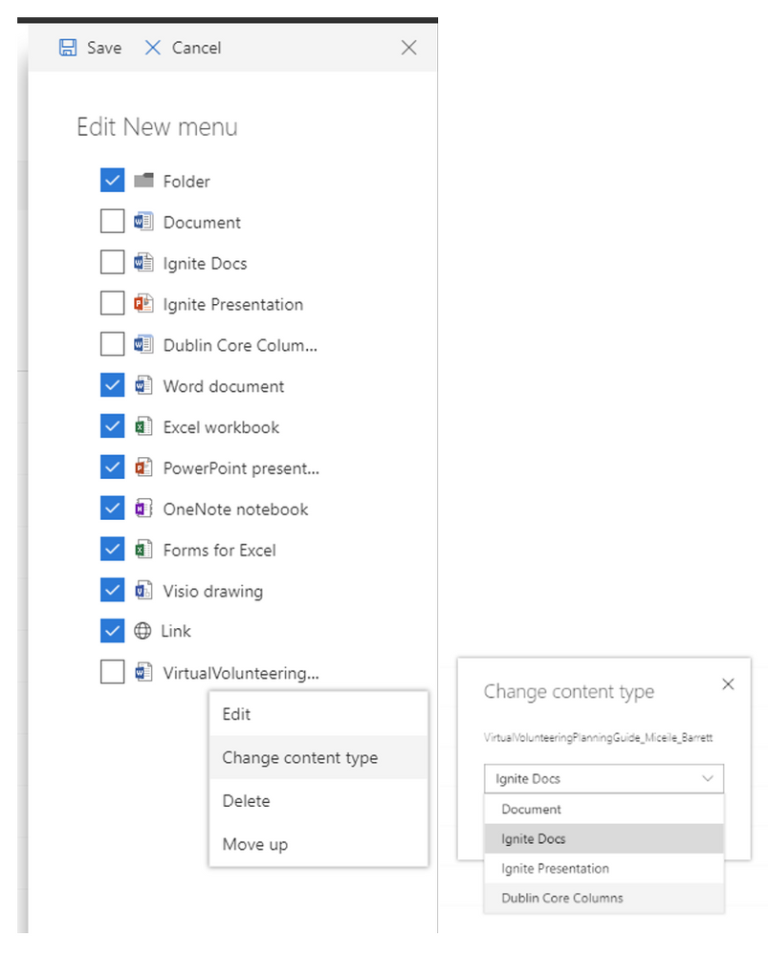
SharePoint Online Content Services
Metadata-driven labels – Automatically apply retention labels to content with rules based on content types and metadata
Document templates – Add document templates to the New menu in libraries
Modern document sets – Use the modern user experience to work with document sets in SharePoint
https://youtu.be/CIwu6OOAkXA

Slide 33
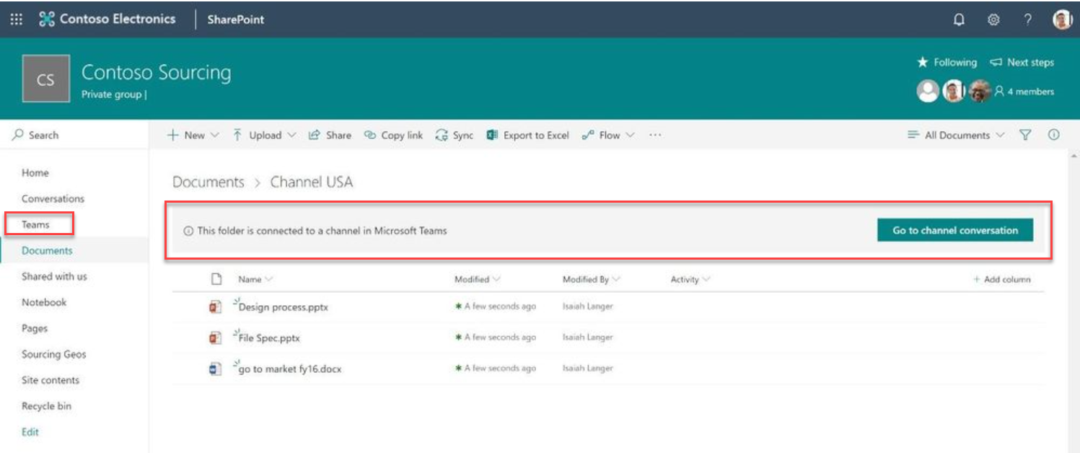
SharePoint Online + Teams
New Files Experience in Teams – Mimics SharePoint
Visual Indicators of Channel Folders in SharePoint Sites
Link to Teams in Site Navigation

Slide 34
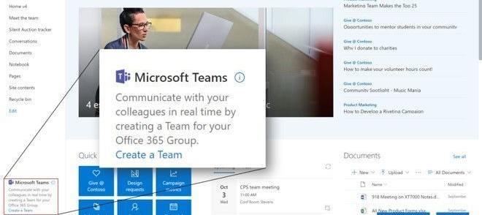
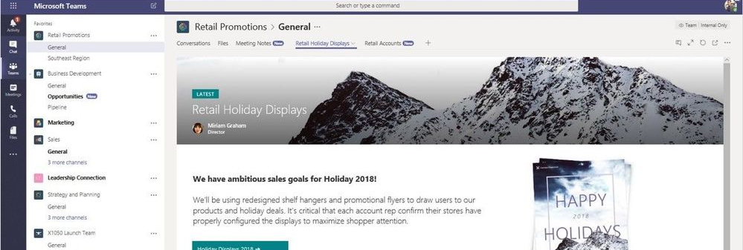
SharePoint Online + Teams
SharePoint List as a Tab in Teams
SharePoint Page in Teams
Connect Any SharePoint Team Site to Teams

Slide 35
SharePoint Online + Teams
SharePoint web parts as tabs in Teams
Teams connectors as SharePoint web parts for pages and news
Notes:
SharePoint web parts as tabs in Teams – We’re working towards directly exposing SharePoint web parts as tabs in Microsoft Teams - including their configuration options. Now, your custom development can be used in more places throughout your organizations collaboration and communication efforts.
Teams connectors as SharePoint web parts for pages and news – We’re working towards directly exposing Teams tabs as full-page apps in SharePoint - including their configuration options. Now your SharePoint sites can take full advantage of the rich ecosystem of service providers who are building integration with Microsoft Teams.

Slide 36
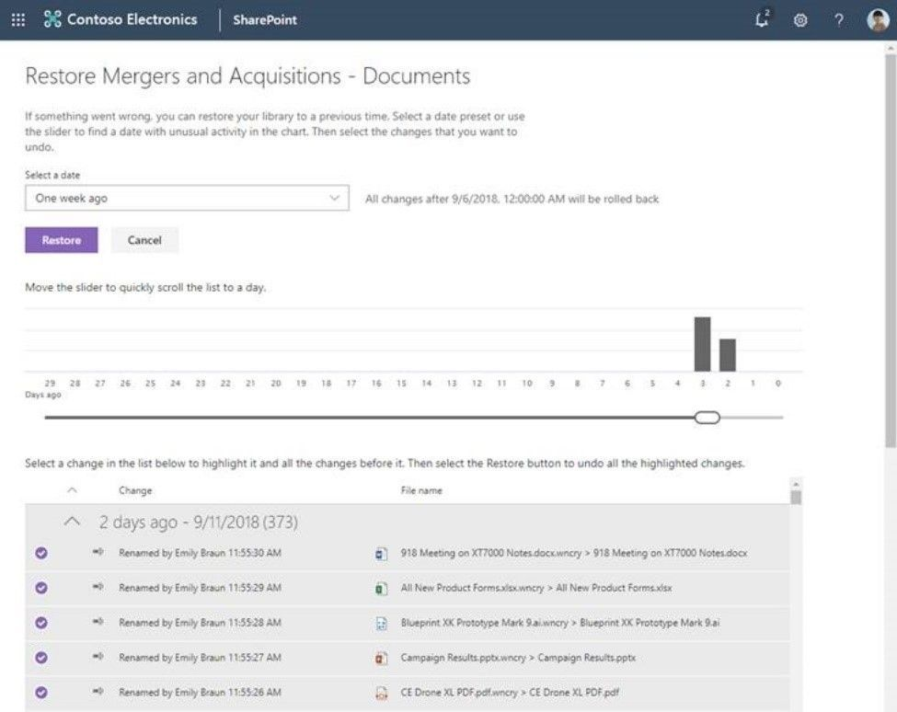
SharePoint Online and Teams Files Restore
Files Restore is a complete self-service recovery solution that allows site administrators restore document libraries from any point in time during the last 30 days and rewind changes using activity data to find the exact moment to revert to.

Slide 37
SharePoint Online Resources
Blog: New innovations in SharePoint & Microsoft 365 deliver power and simplicity for content collaboration
Blog: Build your modern intranet with SharePoint in Office 365
Blog: SharePoint powers teamwork in Office 365
Blog: Microsoft 365 is the smartest place to store your content
Blog: What’s new in security, compliance and administration
Blog: Elevate organizational knowledge with Microsoft Content Services
Documentation: Build your modern intranet on SharePoint in Office 365
Documentation: Planning you SharePoint hub sites
Ignite Session:

Slide 38
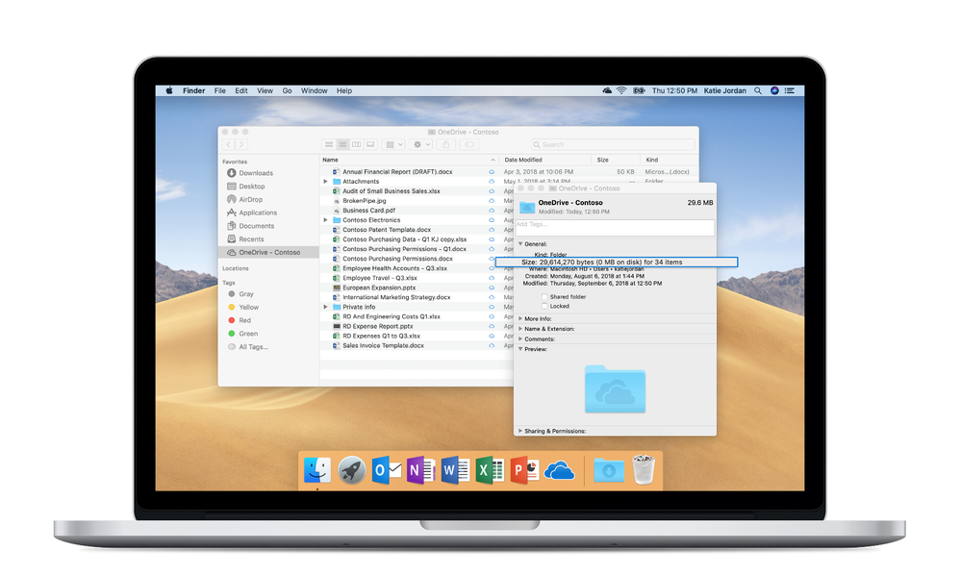
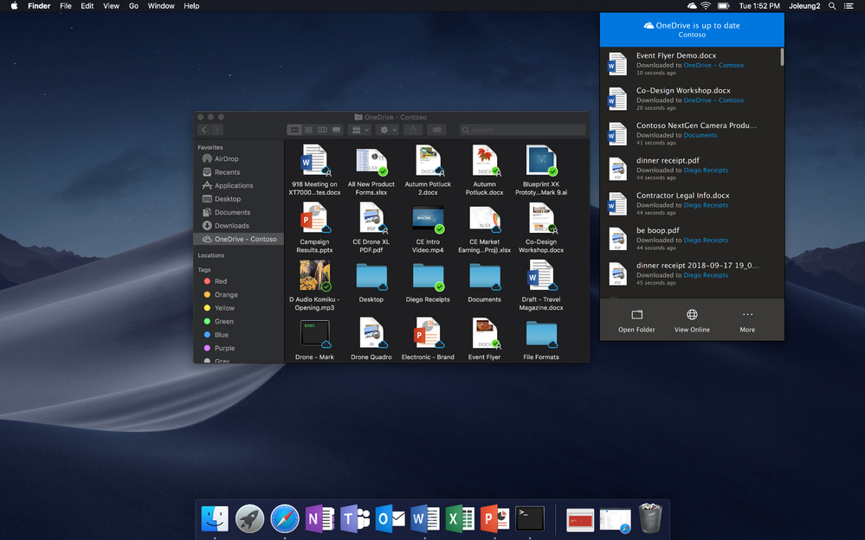
OneDrive for Business
Files on Demand for Mac
Notes:
Available for Office Insiders on mac OS Mojave. Dark mode for OneDrive App is now available as well.

Slide 39
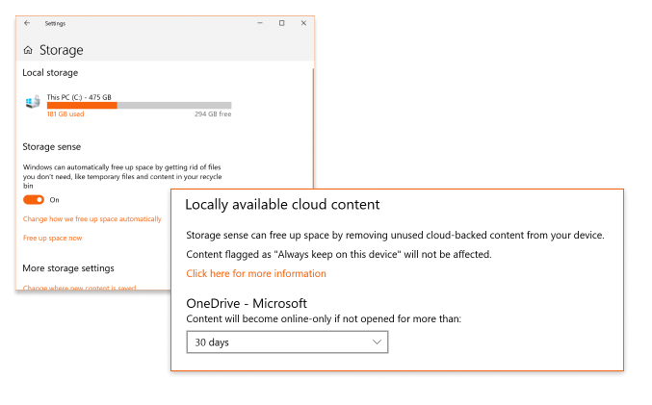
OneDrive for Business
Files On-Demand IT Admin capabilities:
Enable on devices by default
Select folders or files to always be locally available
Block apps from downloading files
Storage sense integration (Windows)
Notes:
IT admins will have the controls they need to manage and deploy with options to enable Files On-Demand by default, select folders or files to always be locally available, and block apps from downloading files. Additionally, Files On-Demand works the same on Mac and PC simplifying end-user training.
Windows can automatically free up space by getting rid of files you don’t need, like temporary files and content in the recycle bin. Storage Sense can be set run automatically when you’re low in disk space. Starting with the Windows 10 release in Oct, Files On-Demand will now be part of that feature. When disk space runs low, Storage Sense will take the oldest files on your computer (that are not marked as “always keep on device”) and move them back to a cloud-only state to help keep disc usage low.

Slide 40
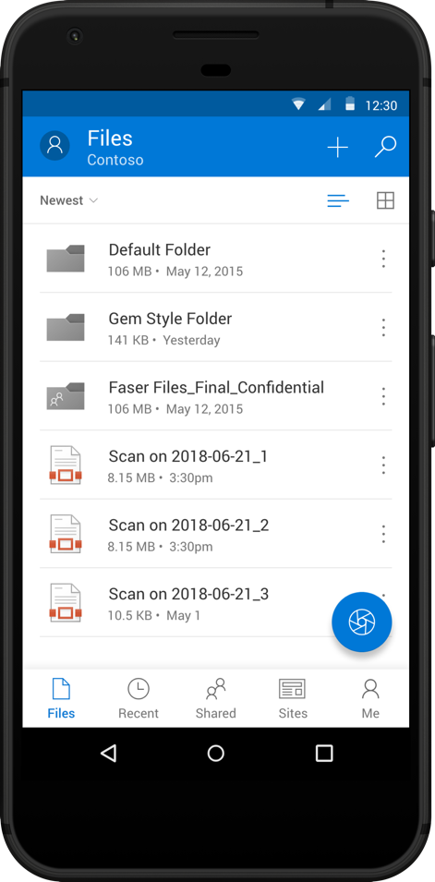
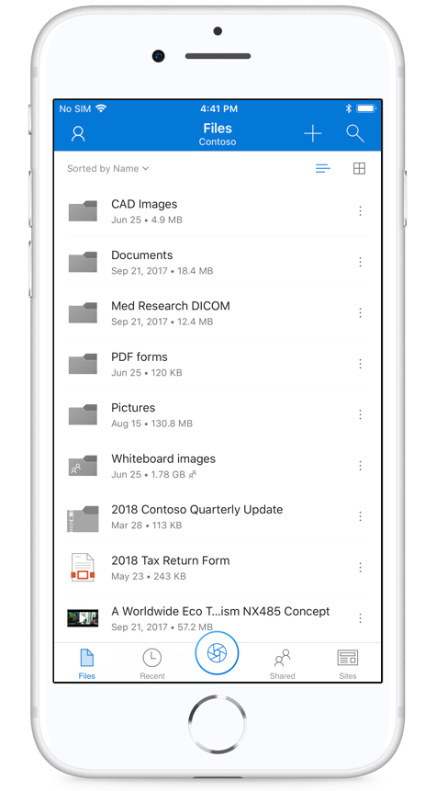
OneDrive For Business
Sync across organizations (SP and OD4B)
AutoCAD Support (SP and OD4B)
Enhanced Office Lens Experience
Notes:
Sync across organizations - We have heard that many customers wanted to sync OneDrive folders shared by users outside of their organization, such as partners, external contractors, and suppliers. We are pleased to announce that you’ll soon be able to sync folders from multiple Office 365 tenants on both PC and Mac.
Office Lens Enhancements - We’re also adding new functionality to the capture experience on iOS and Android. Now, when saving a scanned document or image to a shared library in SharePoint, users will be able to add metadata that will be uploaded – along with the document or image – to the selected library. This capability helps unlock potential new uses cases and workflows right from your phone.

Slide 41
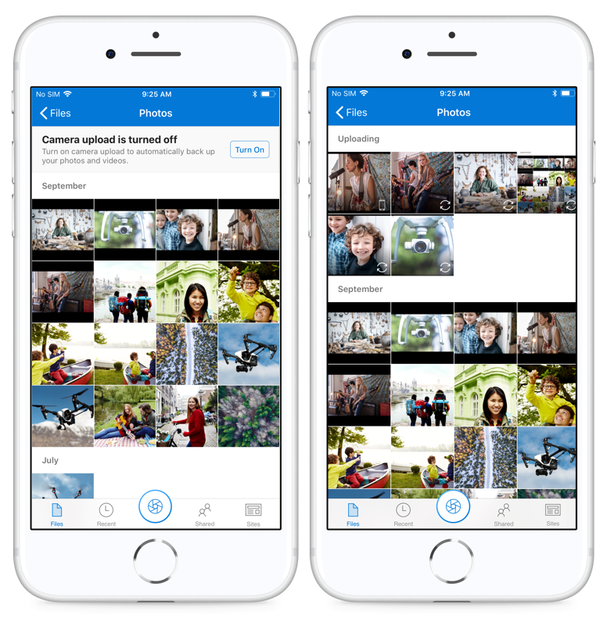
OneDrive For Business
Camera Upload
Notes:
Now available for OneDrive for Business accounts on iOS and in beta for Android. With Camera Upload, OneDrive ensures that critical business media captured on a mobile device stays managed and secured by your organization.
OneDrive automatically uploads all photos and videos on the device Camera Roll to the selected OneDrive for Business account. These photos and videos are automatically sorted and grouped by year and month under the “Camera Roll” folder automatically created in the “Pictures” folder.
Note: only one account may be used at a time for the Camera Upload feature. Note: only one account may be used at a time for the Camera Upload feature.

Slide 42
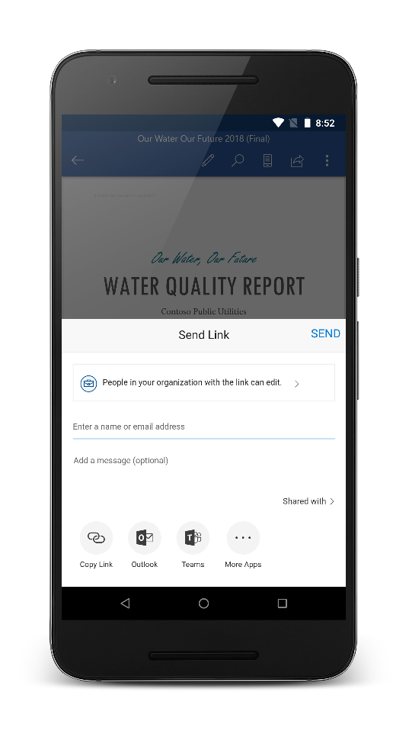
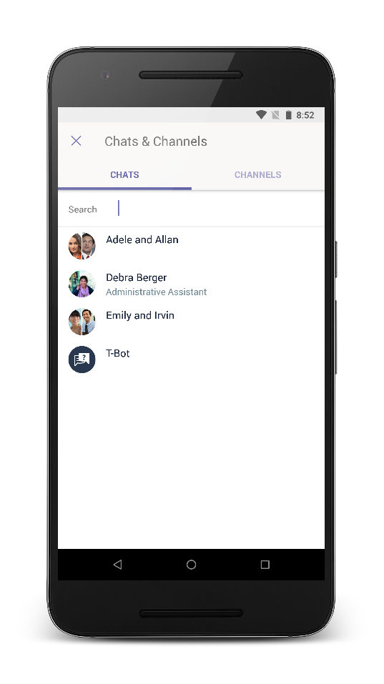
OneDrive For Business
Share to Teams
Notes:
OneDrive now makes it even easier to take content on your desktop or mobile device and share it with any team you a member of in Microsoft Teams. One tap and now everyone is in the know.

Slide 43
OneDrive For Business
Meeting note sharing
Notes:
We integrated with Outlook’s calendar information so now when you use the app to capture your notes or whiteboard during a meeting, OneDrive will intelligently prompt you to share the file with the other meeting attendees.

Slide 44
OneDrive for Business
Intelligent Sharing
Notes:
First is the option to easily share relevant content with meeting attendees. For instance, if you just presented a PowerPoint presentation, you’ll be prompted to share it with the other attendees once the meeting is over. If you took a photo of the whiteboard from the OneDrive app, you will be prompted to share it as well.

Slide 45
OneDrive For Business
Comments on non-Office files. Now supports photos, CAD drawings, PDF’s, or any of the over 320+ file types that we currently support. Users can easily leave notes, collaborate and get notifications when mentioned to ensure you are always in the loop.
Notes:
This feature will allow you to work together not just in Office documents but with photos, CAD drawings, PDF’s, or any of the over 320+ file types that we currently support. Users can easily leave notes, collaborate and get notifications when mentioned to ensure you are always in the loop.

Slide 46
OneDrive for Business
File Activity
Notes:
When a user now opens an Office document stored in SharePoint, they can now visit the Info tab in the backstage of Office to see the total number of views and unique viewers of the document.
This type of real-world intelligence allows you to quickly keep everyone informed and move on to your next task and is exclusively available when you store your content in OneDrive and SharePoint.

Slide 47
OneDrive for Business
Enhanced File Analytics on iOS Realtime Stats & Views

Slide 48
OneDrive for Business
One-click access approval via outlook desktop app and Outlook on the web

Slide 49
OneDrive for Business
Blog: OneDrive Announcements at Ignite 2018
Documentation: IT Pro OneDrive Deployment Guide
Documentation: OneDrive Help Center

Slide 50
SharePoint 2019 On-Premise support
OneDrive.exe client – Using the latest client
OneDrive Files On-Demand

Slide 51
PowerApps
Support for rich text fields
Forms in SharePoint Mobile
Integration with SharePoint libraries
PowerApps Web Part
US GCC Cloud Support for PowerApps and Flow
PowerApps Auditing
Notes:
PowerApps support for rich text fields – Use PowerApps to view and update rich text stored in SharePoint formatted text columns
PowerApps forms in SharePoint Mobile -- Link directly to list and library PowerApps-based forms while browsing lists and libraries in the SharePoint mobile application
PowerApps integration with SharePoint libraries – Build apps and forms that use SharePoint libraries as a data source
US GCC Cloud Support for PowerApps and Flow - Run PowerApps and Flow solutions in tenants on the U.S. GCC sovereign cloud
PowerApps Auditing – Track PowerApps administrative actions inside the Office 365 audit center

Slide 52
Microsoft Flow
Set a reminder
Request sign-off
Content approvals
Page approvals
Hub Join approvals
SharePoint Permissions

Slide 53
PowerBI
PowerBI web part
PowerApps on PowerBI Dashboard
Reports from CSV files in SharePoint libraries

Slide 54
Microsoft Teams
Add pages and lists to a tab in any Teams channel
Browse available assets without cut and paste
Deliver data, apps and content to SharePoint and Teams from unified location

Slide 55
Microsoft Teams Meetings
Background Blur
Meeting Recording
Cloud video interop
Notes:
Background blur: Now, all Teams customers can remove distractions and focus your video on what matters most. Available today. (You are welcome, BBC Dad.)
Meeting recording: Meetings are no longer just a point in time experience. With meeting recording in Teams, you or other invitees who missed the meeting can playback recorded audio, video and content at any time. Pull up a transcript, powered by Microsoft Stream, and search for keywords so you can optimize your time while getting caught up. Available today.
Cloud video interop – Bring your existing room technology investments into Teams. Through partner offerings from Polycom, BlueJeans and Pexip, a full portfolio of legacy devices can now be full-fledged audio/video participants in Teams meetings with content sharing. Polycom’s CVI offering is available now, with Pexip and BlueJeans generally available by end of October.

Slide 56
Firstline Workers
Hub for all workers
Home – Most important info of the day
Shifts – Schedule Planning and Employee Self-service
Resources:
Support: Microsoft Teams for firstline workers
Support: StaffHub retired
Notes:
Home is a new mobile experience that allows firstline workers to see at a glance the most important and relevant info for their day. With Home, firstline workers can clock in and out of shifts/breaks, receive important notes for the day or shift, find out who is working during the shift and save time by easily reviewing information and schedule.
Shifts enables firstline managers to plan schedules in an employee self-service and integrated experience. They can create, update and distribute schedules for teams as well as broadcast open and unfilled shifts so that other employees can cover them. Finally, they can review and accept time off requests and swap shifts – all from mobile. For firstline employees, they can swap/offer shifts and request time off, right from their phones.

Slide 57
Microsoft Teams Secure Messaging
Image annotation
Priority notifications
Care Coordination (healthcare)
Notes:
Image annotation – capture images, annotate, and share them on a secure platform. IT Admins can set policies to prevent images from being stored on a mobile device or local drive.
Priority notifications– alert the recipient to an urgent message and automatically notify the recipient every two minutes for up to twenty minutes.

Slide 58
Security & Compliance
Unified Labeling – Azure Information Protection and Office 365 have merged to provide a consistent approach
Blog: Updates to Advanced Data Governance: Unified labeling, analytics, file plan and more
Notes:
The unified labeling experience in Microsoft 365 is now generally available, providing organizations with a more integrated and consistent approach to creating, configuring and automatically applying comprehensive policies to protect and govern your data across devices, apps, cloud services and on-premises locations.
Now you can use the advanced data governance capabilities to auto-classify your Exchange content in addition to SharePoint content. Use the same sensitive data types, keyword or query based conditions to classify and label the email content in your organization to ensure that important data has the proper management policies in place to meet your organizational and regulatory needs.
Blog: Updates to Advanced Data Governance: Unified labeling, analytics, file plan and more
Blog: Announcing availability of information protection capabilities to help protect your sensitive data

Slide 59
Security & Compliance
Information Protection
Capabilities:
Centralized management of labels and protection settings in the Security & Compliance Center
Microsoft Information Protection SDK
Preview of labeling functionality in Word, PowerPoint, Excel and Outlook on Mac
Preview of labeling in Word and PowerPoint on iOS and Android
Endpoint protection based on sensitivity labels using Windows Information Protection
Preview of viewing labeled and protected PDFs in Adobe Acrobat Reader on Windows
Preview of Information Protection analytics
Extend information protection to non-Microsoft apps and services with Microsoft Information Protection SDK
Enhancements to Office Message Encryption (OME)
Resources:
Blog: Announcing availability of information protection capabilities to help protect your sensitive data

Slide 60
Security & Compliance
Label Anayltics
Notes:
Establishing information rules is just the start of governance. You also need to measure the application and usage of labels to understand how your file plans are effective, and where they may require updates. Label analytics allows you to map and review the usage of retention labels, providing feedback to help continuously adjust and improve governance.

Slide 61
Security & Compliance
Content Type autoclassification
Notes:
Map content types to retention labels by using a content type as an autoclassification query to apply retention on a content type in SharePoint online.

Slide 62
Security & Compliance
1 Year Audit Log Retention
Notes:
Note: The one-year retention period for audit records will be available soon as part of the Office 365 Preview program and will be only available for organizations enrolled in the Preview program.
When the longer retention period for audit records does become available in Preview (and later for general availability), only new audit records (for activities performed after the longer retention period is released) will be retained for one year.

Slide 63
Security & Compliance
Administrator hold on video and audio - By leveraging the transcription services in OneDrive and SharePoint, you will now have the ability to search across audio and videos files and to find media that contain those keywords or phrases that you have chosen to tag for Administrative hold.

Slide 64
Security & Compliance
Multi-geo for SharePoint and Office 365 Groups
Blog: Introducing Multi-Geo in SharePoint and Office 365 Groups
Ignite Session: BRK3102 – Get started with Multi-geo scenarios with SharePoint and OneDrive
Notes:
Mutli-Geo is not to be construed as a performance measure. There is not guarantee it will improve performance. The main driver behind an organization going multi-geo is to comply with data residency regulations.
Team sites and Communications sites creation experience automatically detects the user’s configured geo-location and triggers sites creations in the corresponding geo.
For organizations that use taxonomy enterprise managed metadata to organize their sites and contents, Multi-Geo enables an easy way to centrally manage metadata in a central location and behind the scene these get replicated to all the satellites and ready to use in satellite sites.

Slide 65
Security & Compliance
Resources:
Blog: Updates to Advanced Data Governance: Unified labeling, analytics, file plan and more
Documentation: Audit Log Planning
Blog: The Microsoft Graph Security API is now generally available

Slide 66
Security & Compliance
Microsoft Threat Protection – Leverages 6.5 trillion daily signals from the Microsoft Intelligent Security Graph
Resources:
Blog: Announcing Microsoft Threat Protection
Ignite Session: BRK4000 - Leveraging the power of Microsoft threat protection to secure the modern workplace across data, endpoints, identities, and infrastructure
Notes:
Enriched by 6.5 trillion daily signals harnessed from the Microsoft Intelligent Security Graph (figure 3). The Intelligent Security Graph serves as the foundation for all of Microsoft’s security solutions, obtaining threat signal from Microsoft’s services, expansive user base, and global footprint. The Intelligence Security Graph blends threat signal with powerful machine learning capabilities, threat analysis from our 3500+ in-house security specialists, and support from over $1 billion in annual cybersecurity investments. The Intelligent Security Graph helps remove the noise from the threat landscape, providing intelligent solutions to mitigate today’s attack campaigns, from generic high volume threats, to more sophisticated and targeted attacks. It is the powerful differentiator which elevates Microsoft’s security solutions to the forefront of the security industry, enabling seamless integration and signal sharing, bringing together a disparate set of services into a cohesive, end to end solution securing the modern workplace.

Slide 67
Security & Compliance
Privileged Access Management (PAM): Zero standing access and just in time permissions to admin tasks in Office 365
Resources:
Blog: Privileged access management in Office 365 is now GA
Ignite Session: THR2256 - Best practices for privileged access management

Slide 68
Security & Compliance
ISO 27011
ISO 27018
NIST 80-53
NIST CSF
CSA CCM
GDPR
UK NHS
HIPPA/HITECH
FFIEC
NIST 800-171
FedRAMP Moderate and High
Resources:
Blog: Proactively assess and enhance your data protection controls with Compliance Manager
Whitepaper: Compliance Manager
Ignite Session: THR2184 – Reduce your time and costs to manage data privacy and compliance using Compliance Manager
Ignite Session: BRK3114 – Manage your tenants security and privacy settings, and protect your organizations data

Slide 69
Security & Compliance
Site Classification
Integrate with Microsoft Info Protection policy labels with rules around retention, conditional access, etc

Slide 70
Security & Compliance
Cloud App Security
Real-time session controls and monitoring for Office 365 and on-premise apps
Cloud App Discovery beyond your corporate network with Windows Defender ATP
Automatic detection and revocation of risky Oauth App permissions
Automating Enterprise workflows with Microsoft Flow
Discovery and app lifecycle management with Secure Web Gateway provider iboss
Resources:
Blog: What’s new with Microsoft Cloud App Security
Ignite Session: BRK2158 – Elevate the security for all your cloud apps and services with the Microsoft CASB – Cloud App Security

Slide 71
Security & Compliance
Secure Score
Resources: Blog: New controls available in Microsoft Secure Score
Ignite Session: THR3041 - Staying Secure with Azure AD and Microsoft Secure Score
Average Score of all tenants at Ignite – Better than average but still long way to go

Slide 72
Thank you

